Slide 1
Making Linear Decisions
Linear Programming Part I

Slide 2
On the Menu for Today
Modeling Linear Decisions
Mathematical Formulations of Linear Programs
Feasible and unfeasible solution
Applications
Lego
Digital Advertising

Slide 3
Modeling
Framework
Typical
problem
Typical
solution
Abstraction
Application
Specific
problem
Specific
solution
Trial & error

Slide 4
Model Building
To solve a decision problem, define
The decision(s)
The objective(s)
The constraint(s)
Notes:
“All models are wrong, but some are useful”
Box
“The purpose of models is not to fit data but to sharpen the questions”
Samuel Karlin
“When you are lost, any old map will do”‖
(Weick, 1995: 54).

Slide 5

Linear Programming at HP

Slide 6
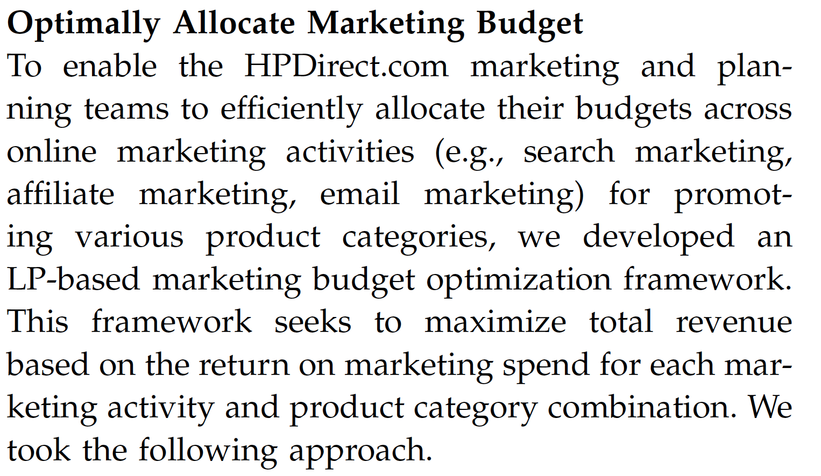
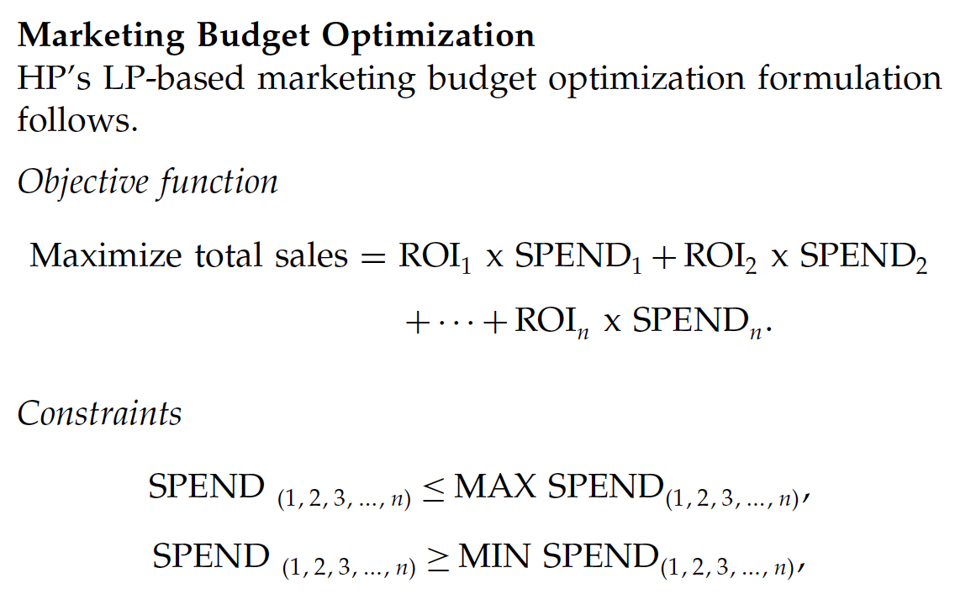
Linear Programming at HP

Slide 7
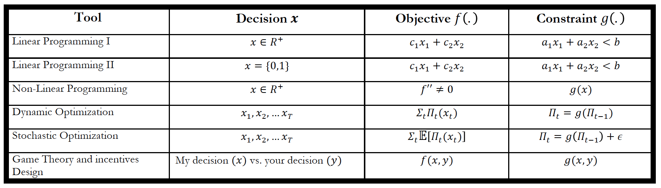
Today

Slide 8
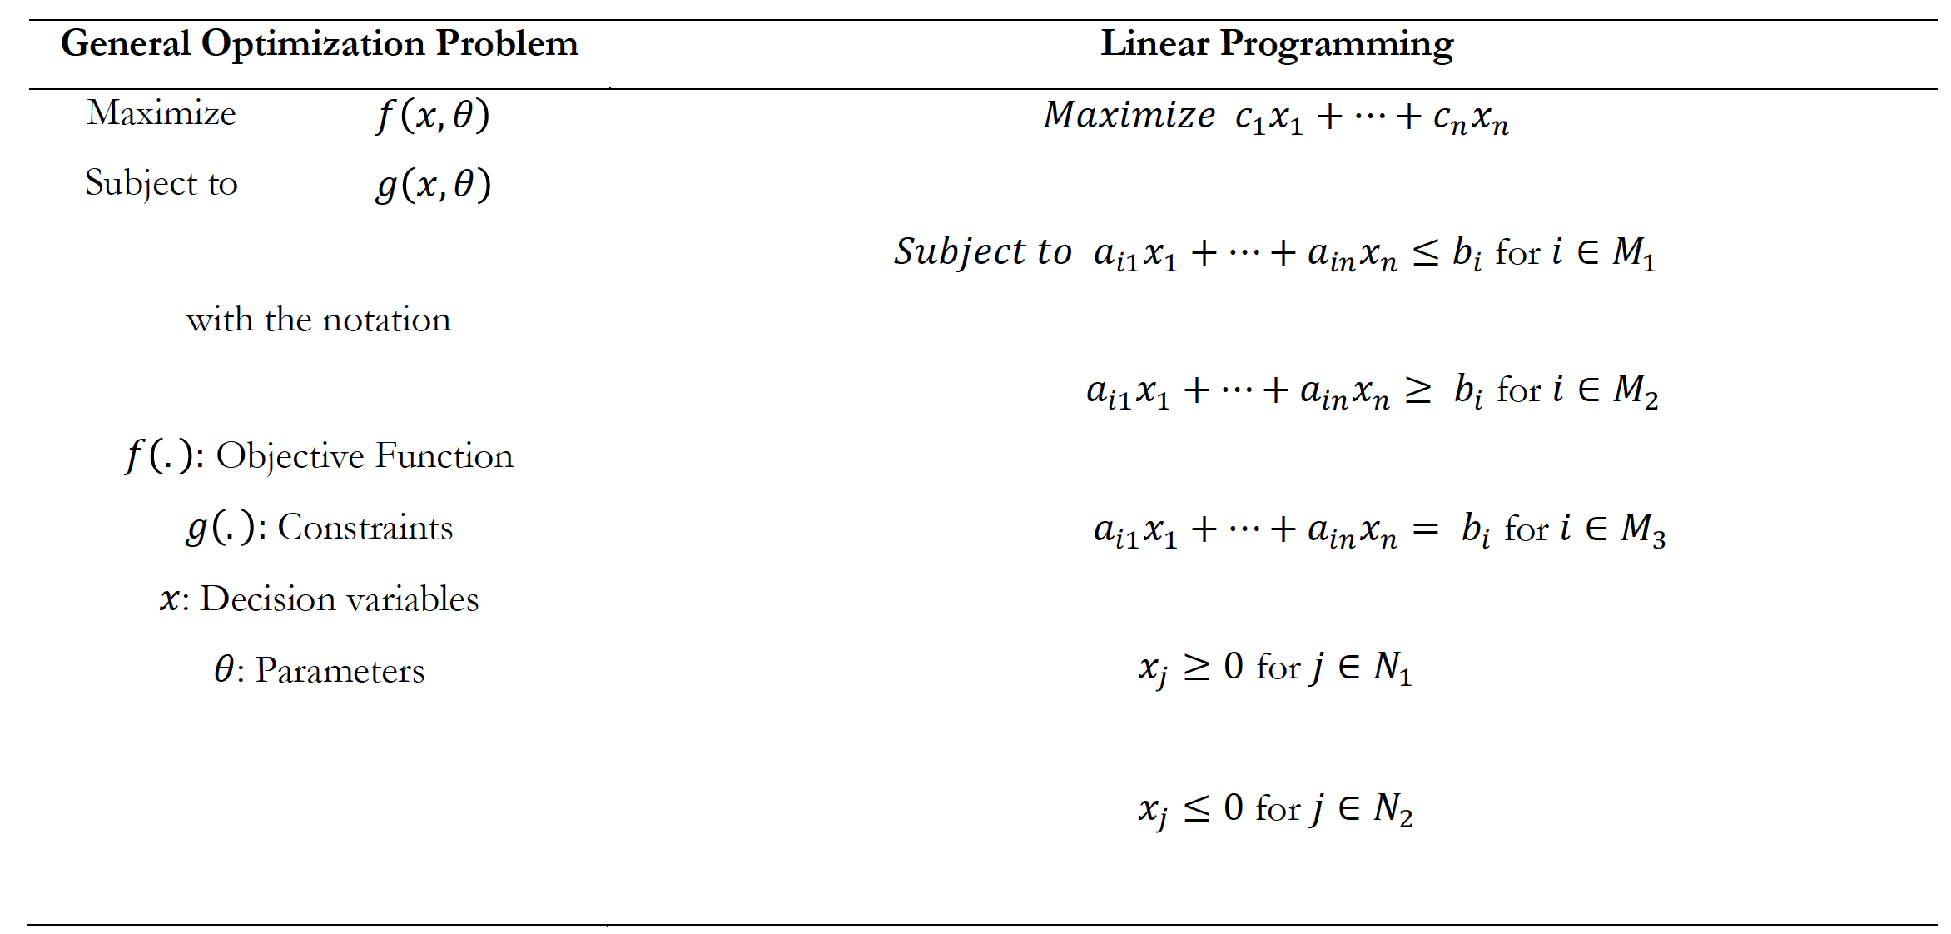
Mathematical Modeling

Slide 9
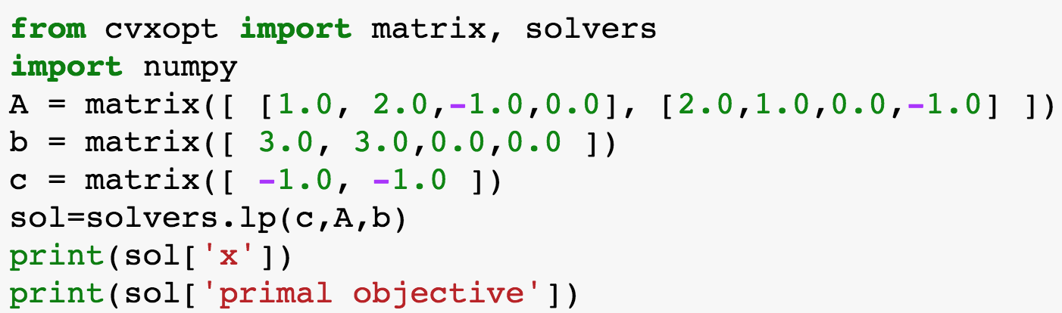
Compact Form

Slide 10
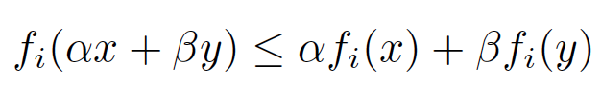
Convex Optimization
Convex optimization
An optimization problem is convex when both the objective function and constraints are convex
It is a framework where differentiability is not necessary
It includes
Continuous and discrete decision variables
Static and dynamic optimization
Deterministic and stochastic optimization

Slide 11
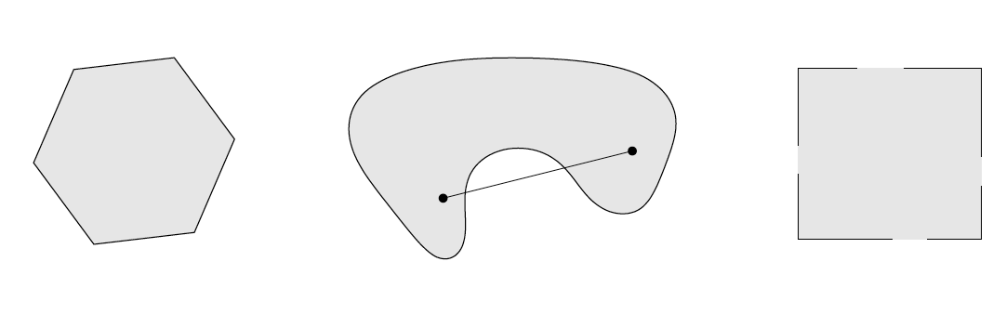
Convex Sets

Slide 12
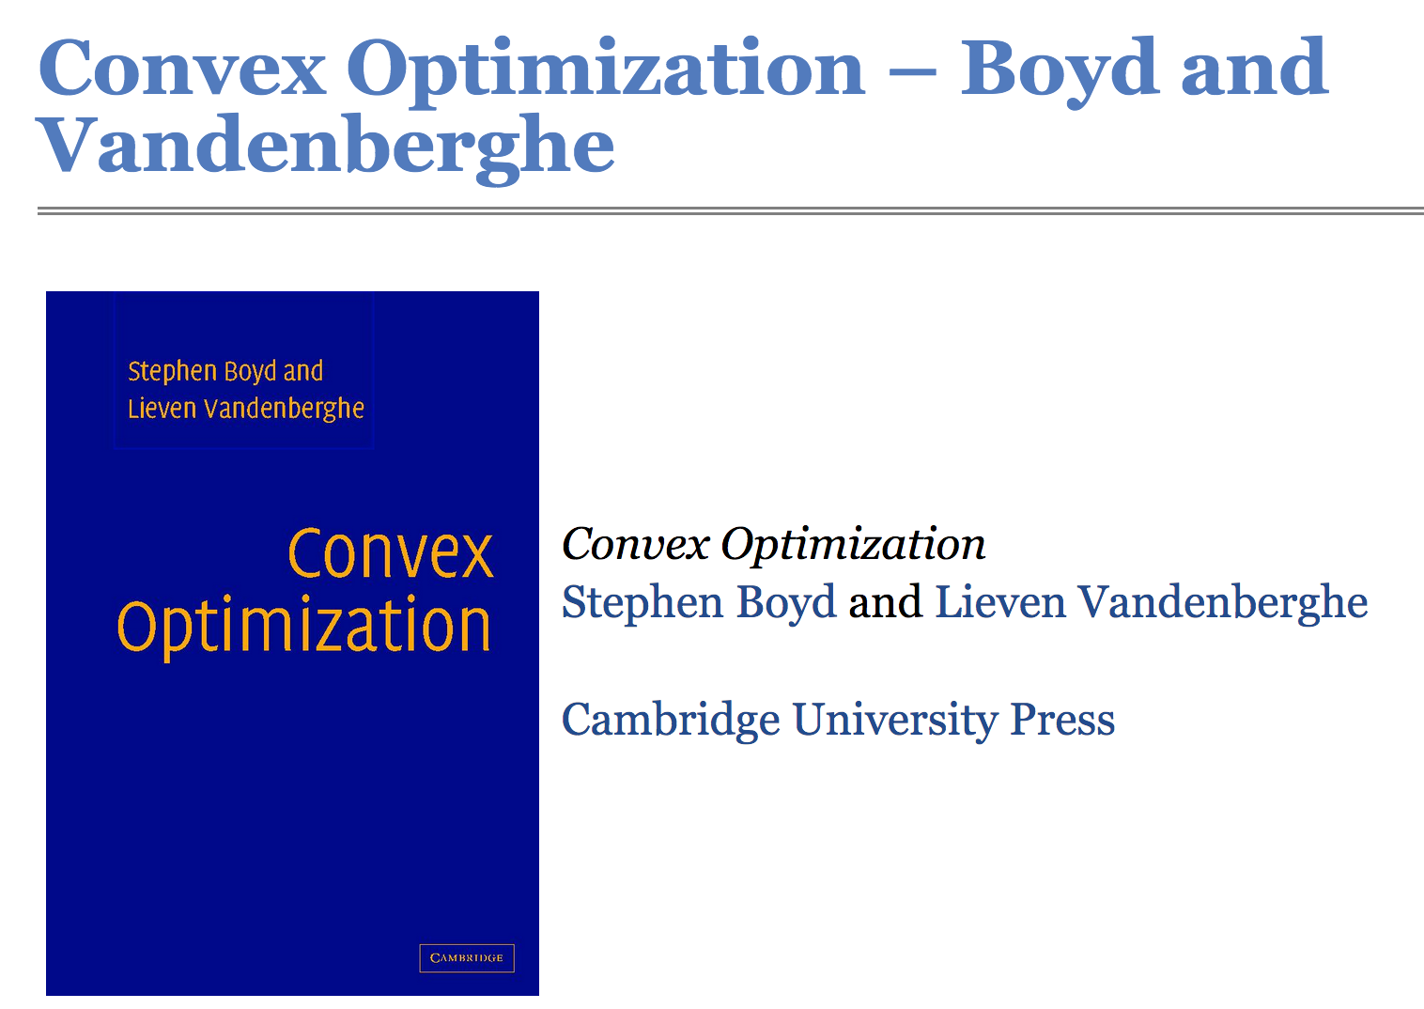
More information on Convex Optimization (also on Canvas)

Slide 13
Intuition for LP

Slide 14
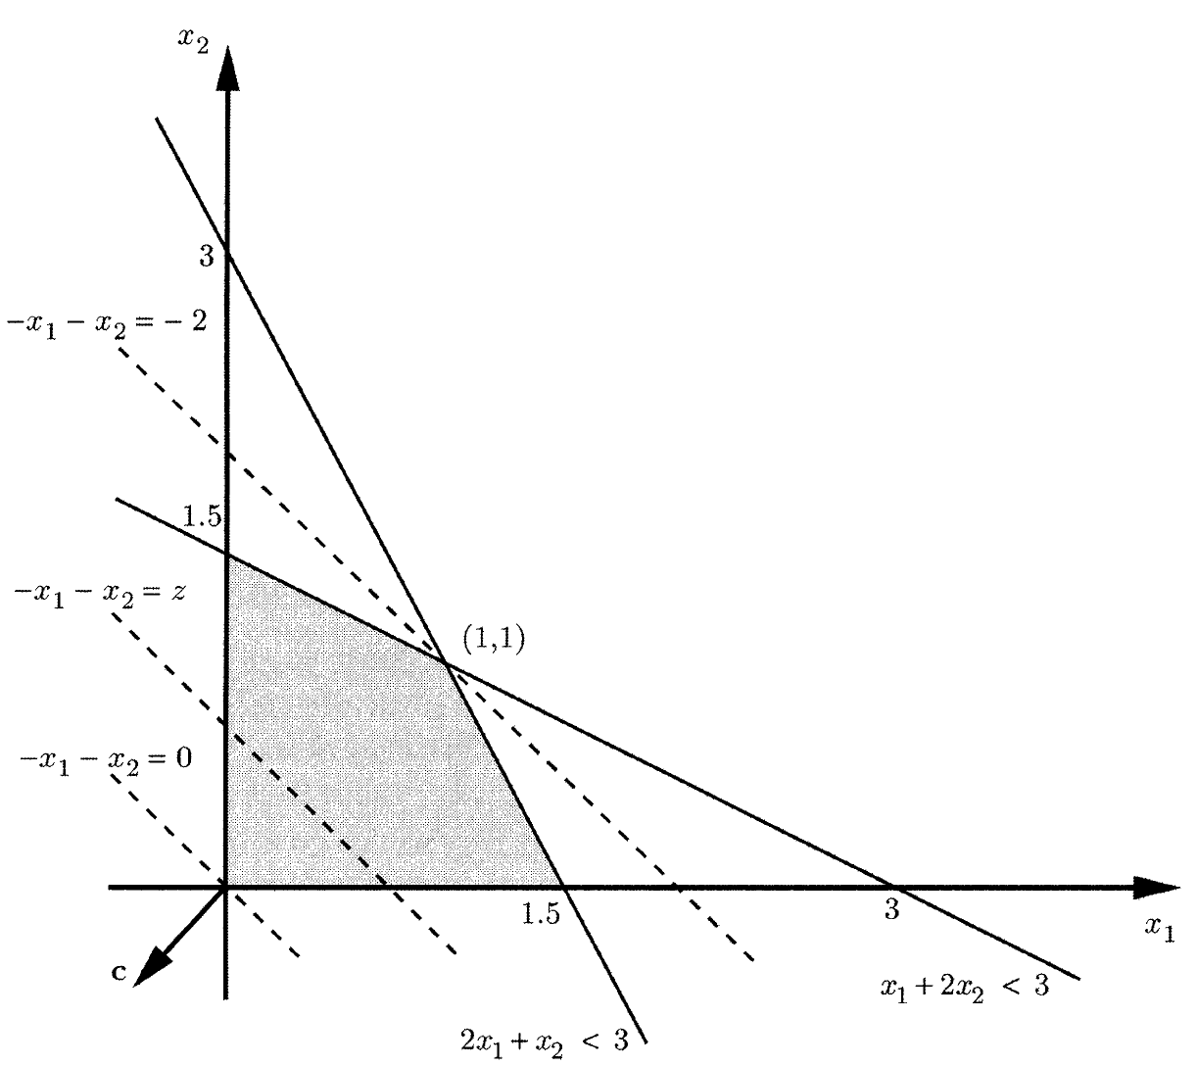
Graphical Intuition

Slide 15
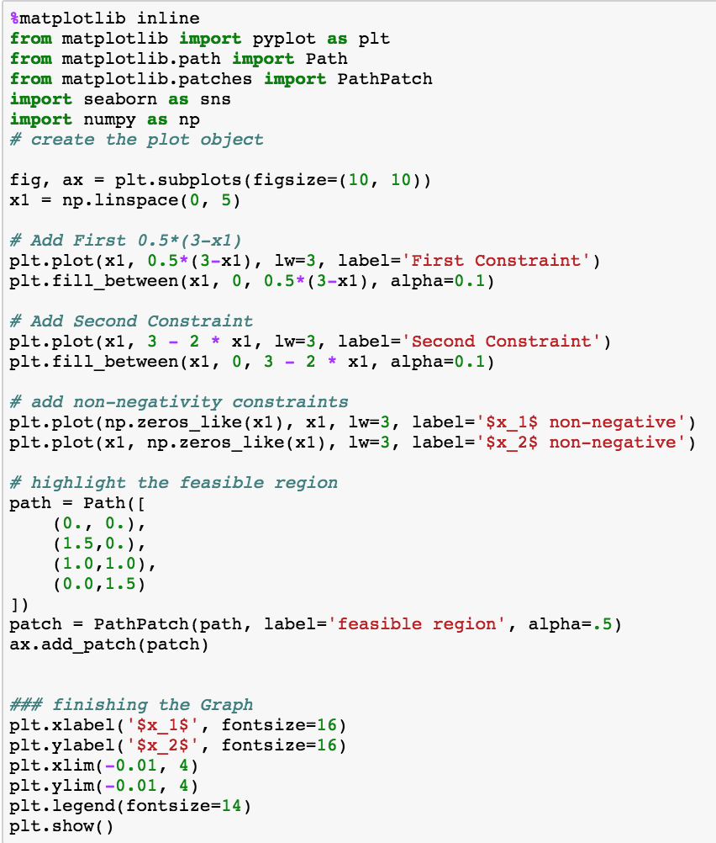
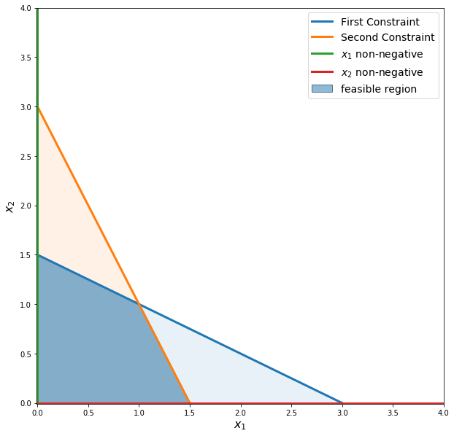
Python Time

Slide 16
Important Considerations
The shaded-area defines a convex set
The convex set is characterized by corners or vertices that are referred to as the “extreme points”.
These extreme points are important as the optimal solution to an LP problem can be found at an extreme point of the feasible region.
When looking for the optimal solution, you do not have to evaluate all feasible solution points. You have to consider only the extreme points of the feasible region.
The constraints can be such that the feasible region is not convex.
The constraints can be such that a feasible region does not exist

Slide 17
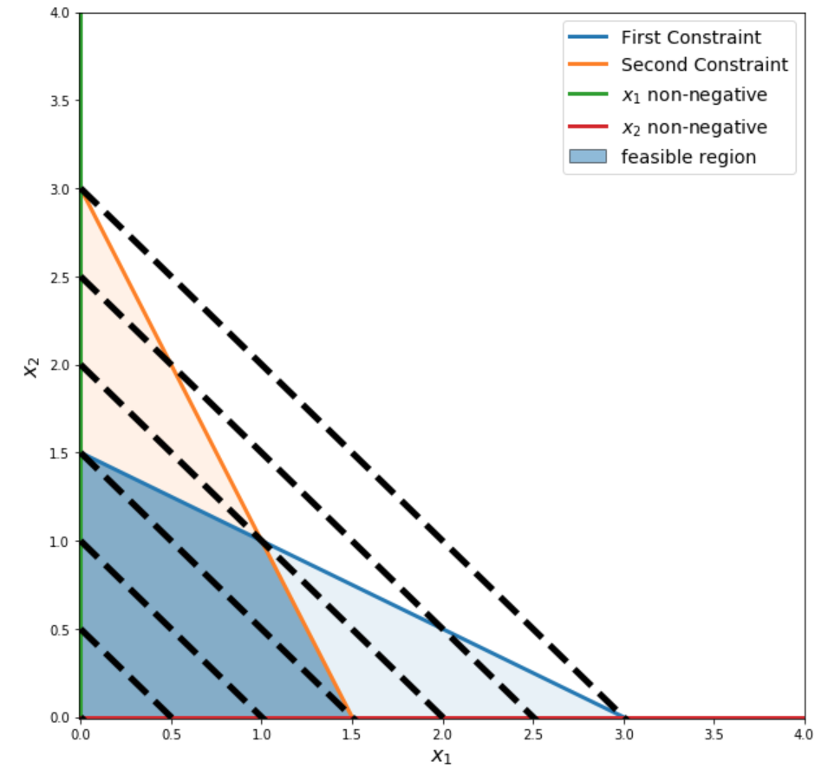
Iso-lines

Slide 18
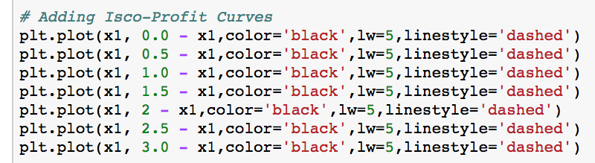
Iso-lines

Slide 19
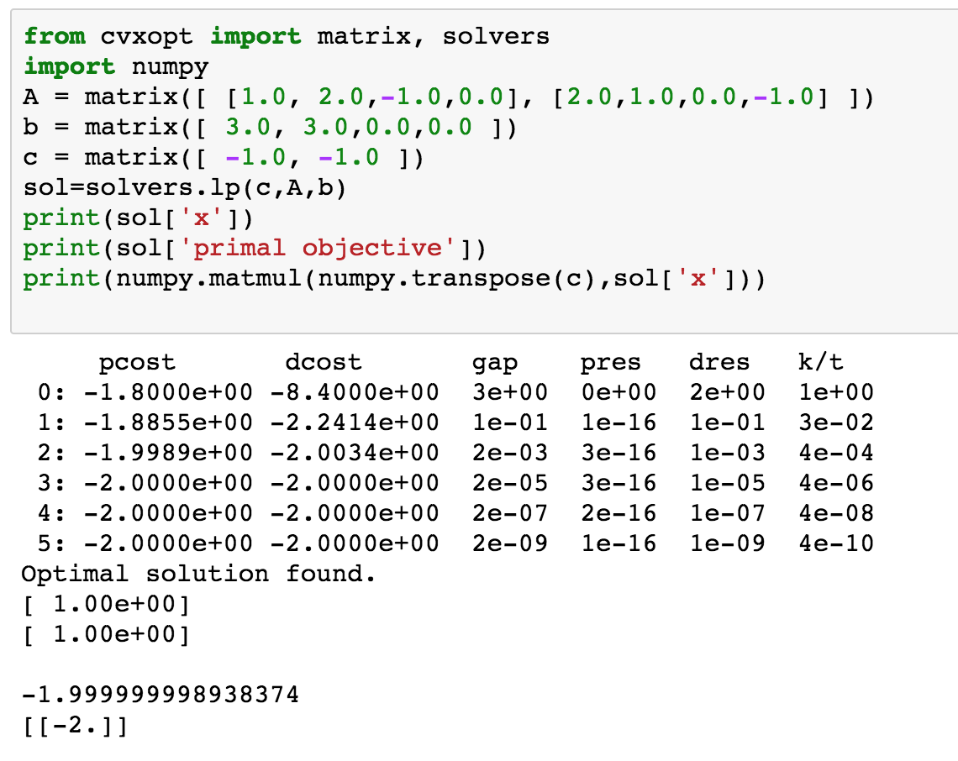
Solution

Slide 20
Sensitivity Analysis
What is the solution now?
Please compute the solution

Slide 21
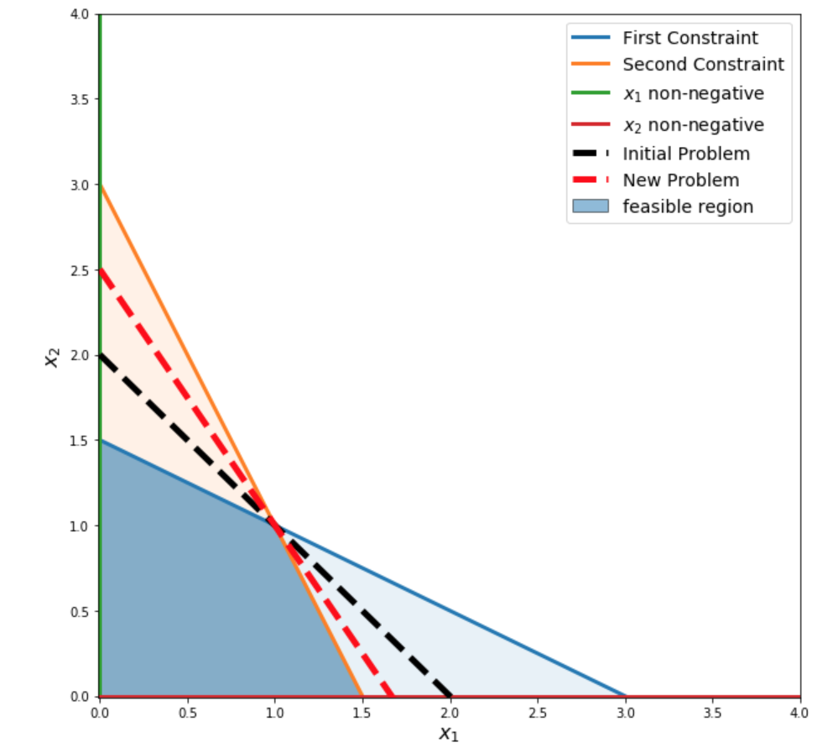
Sensitivity Analysis

Slide 22
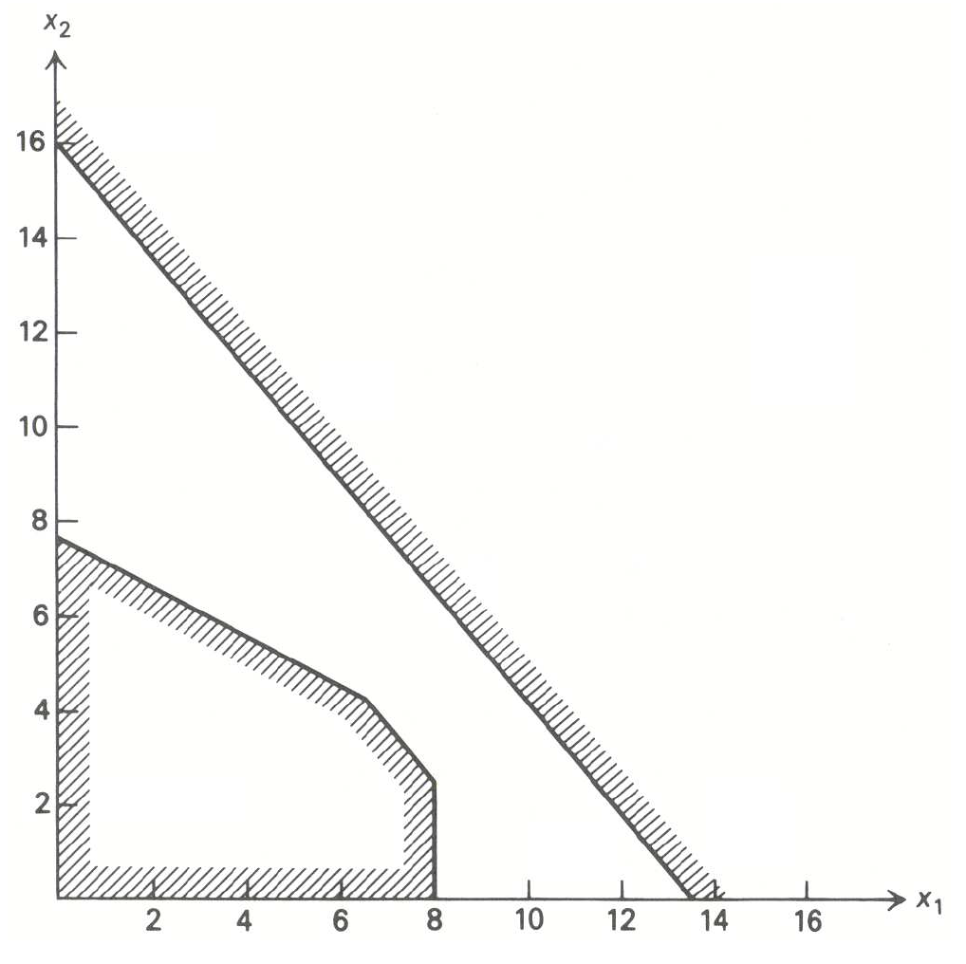
Infeasible Problem

Slide 23
Unbounded Problem
x₂
3x₁ + x₂ > 8
8
Max 3x₁ + 4x₂
5
x₁ + x₂ > 5
x₁
2.67
5

Slide 24
In Other Words
The solution to a maximization linear programming problem is unbounded if the value of the solution may be made infinitely large without violating any of the constraints; for a minimization problem, the solution is unbounded if the value may be made infinitely small.
In practical problems, unbounded solution usually indicates the problem has been improperly formulated.
A solution does not always exist

Slide 25
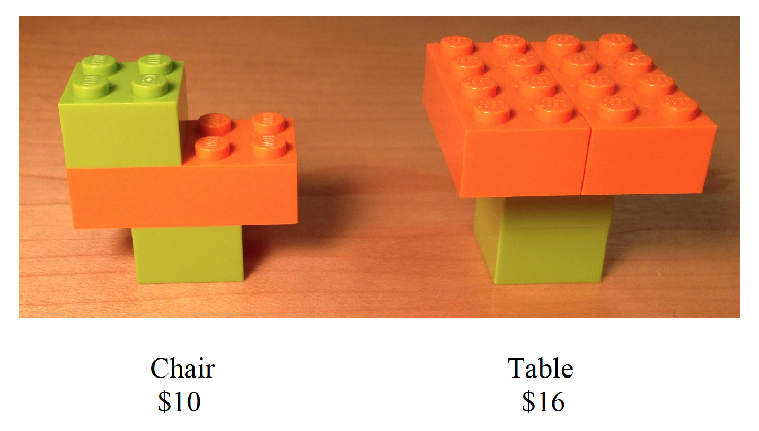
Lego
You are the manager of a Lego Furniture production facility. The current resources available in your factory are 6 large orange Lego blocks and 8 small green Lego blocks.
You can make two kinds of furniture with your available Lego blocks. The first kind is a chair, which retails for $10 and takes 2 green blocks and 1 orange block to manufacture. The second one is a table, which retails for $16 and takes 2 green blocks and 2 orange blocks to manufacture. Both pieces are good sellers and you’ll be able to sell anything you produce.
What should you build in order to maximize revenues?

Slide 26
Modeling
What are the decisions?
What is the objective function?
What are the constraints?

Slide 27
Mathematical Formulation

Slide 28
Mathematical Formulation

Slide 29
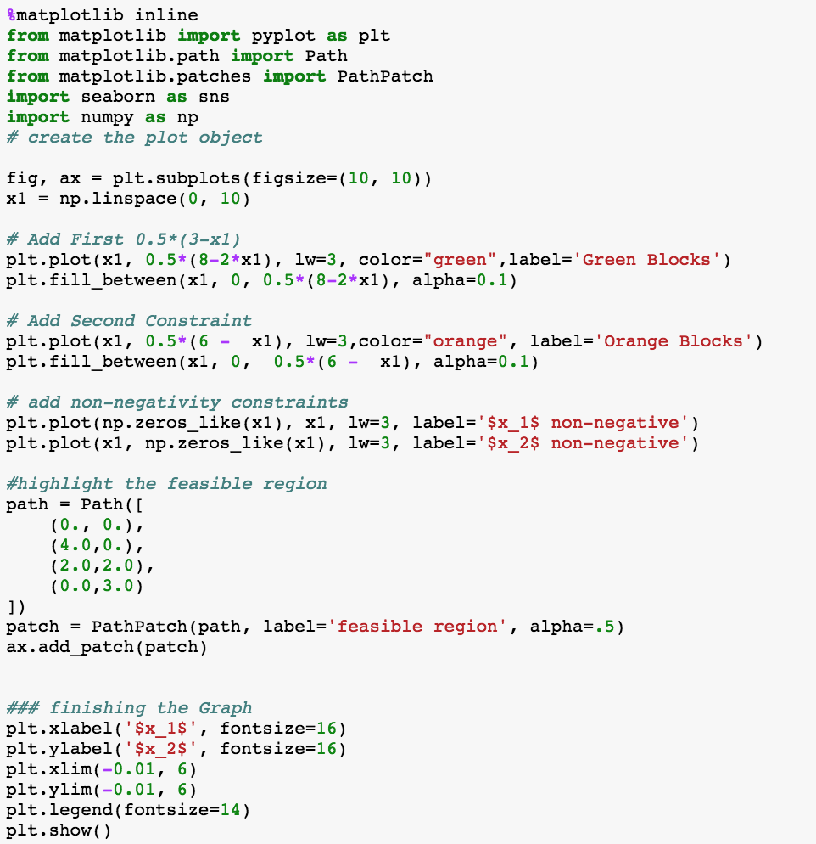
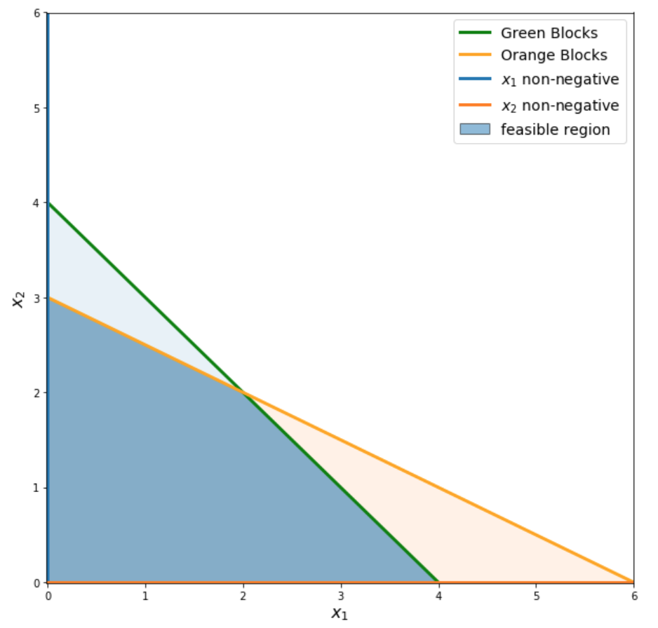
Visually

Slide 30
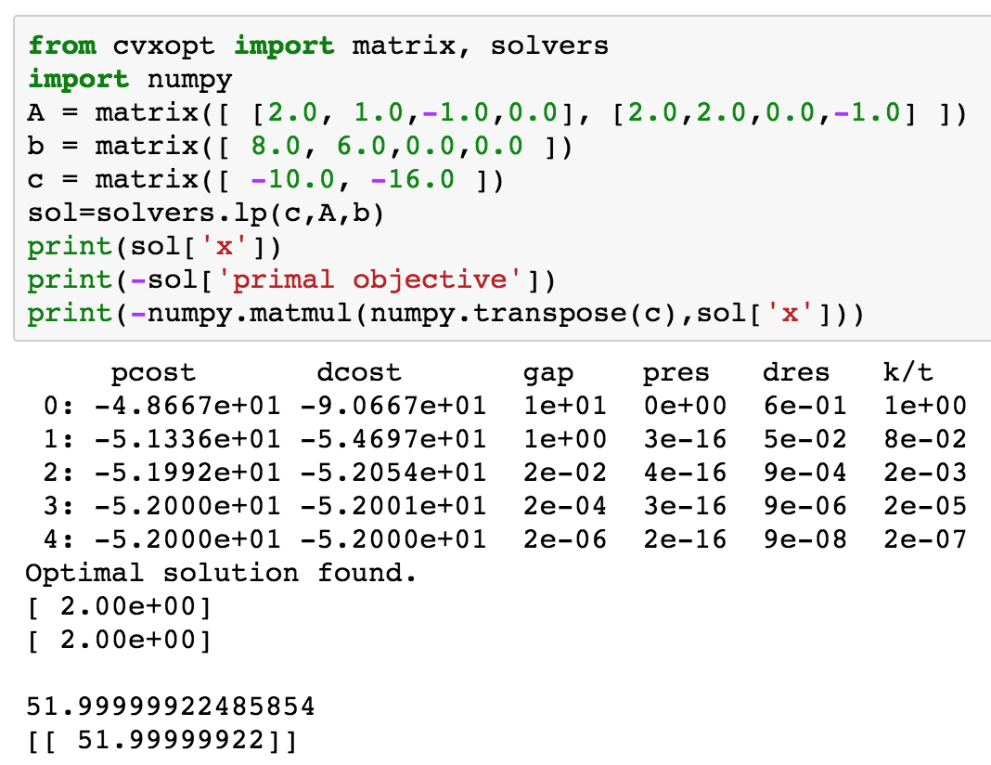
Solution Lego

Slide 31
Auction
I have one block of Lego to sell.
How much are you willing to pay for it?
The answer is…y
Why?

Slide 32
Because of Duality (y is p)

Slide 33
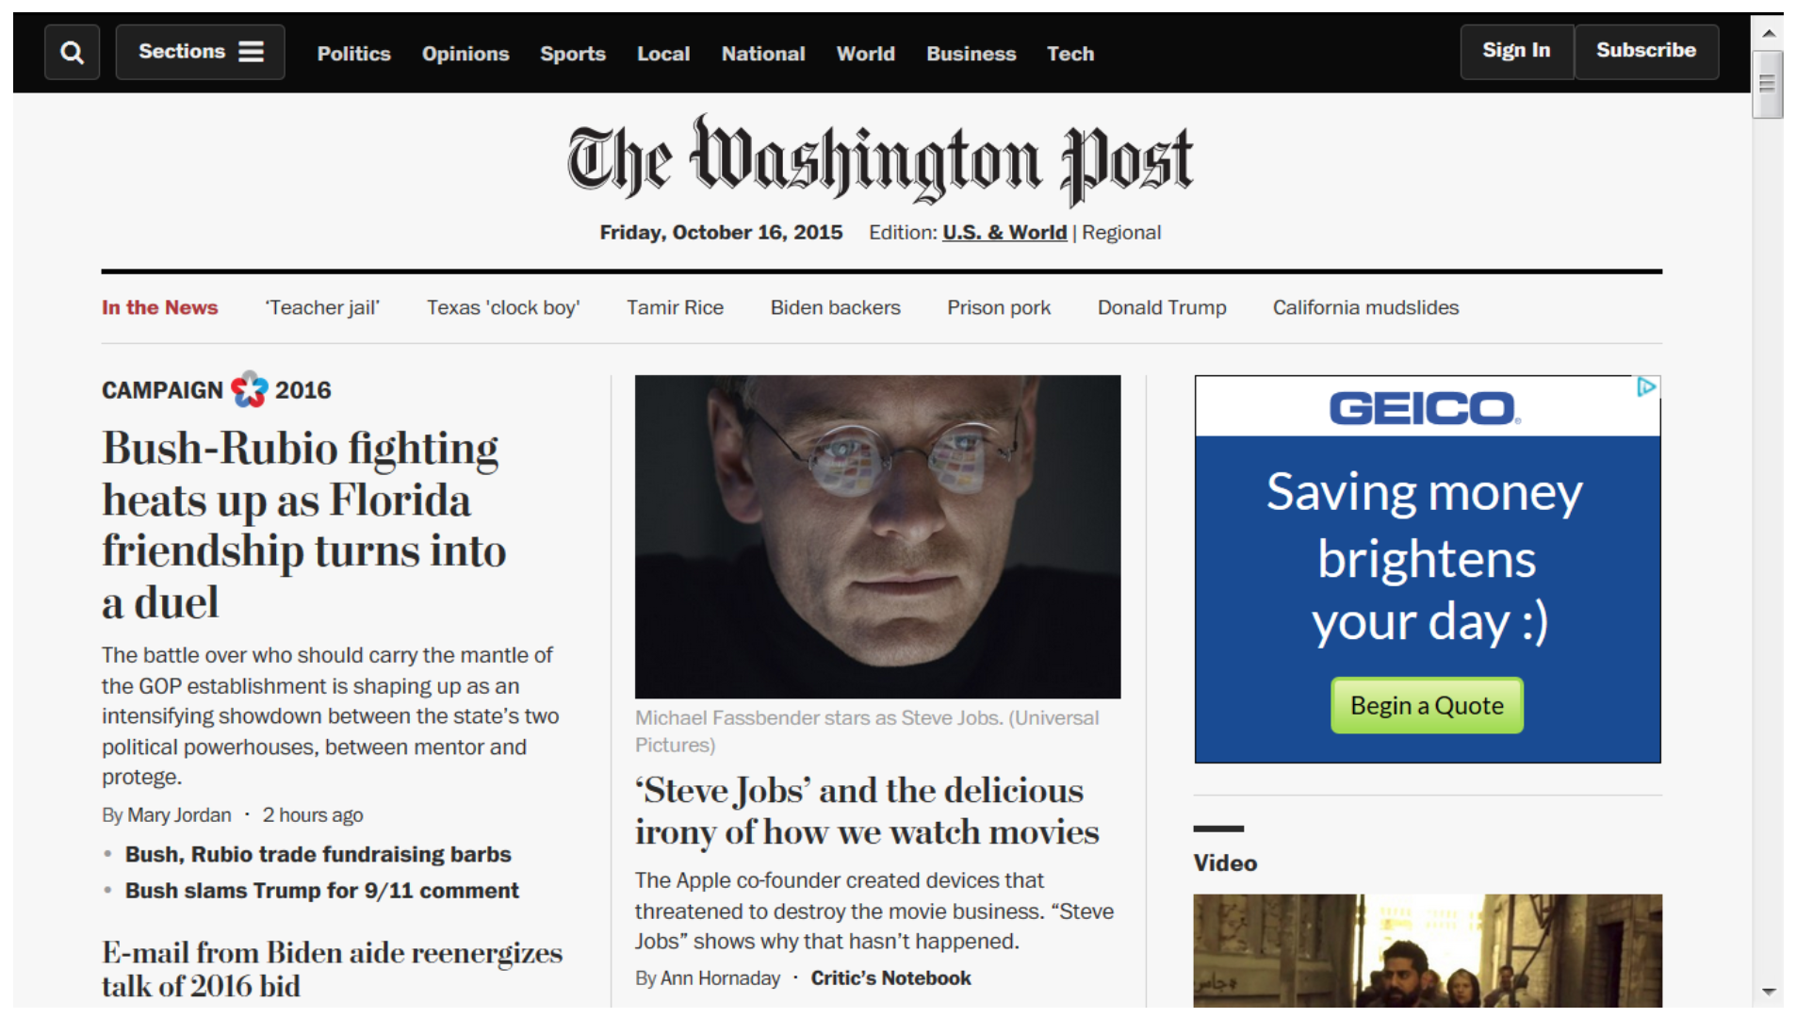
Display Advertising

Slide 34
Display Advertising
Content publishers such as The New York Times, The Washington Post and The Wall Street Journal generate revenue by using display advertisements.
The Washington Post's website contains several different sections including Sports and National, as can be seen above. The number of views each section gets per day can be estimated by analyzing historical data. Assume that the Sports section gets six million views per day and the National section get five million views per day.
Assume four companies, GEICO, Delta, T-Mobile and Capital One, wish to advertise on the Sports and National sections of the Washington Post and they contract directly with the newspaper. For each company, the contract specifies the number of times its display ads are shown in these two sections. The contracts sometimes also specify a total number of page views that can originate from any section of the newspaper. The page views promised by The Washington Post to each advertiser are summarized in Table 1 below.

Slide 35
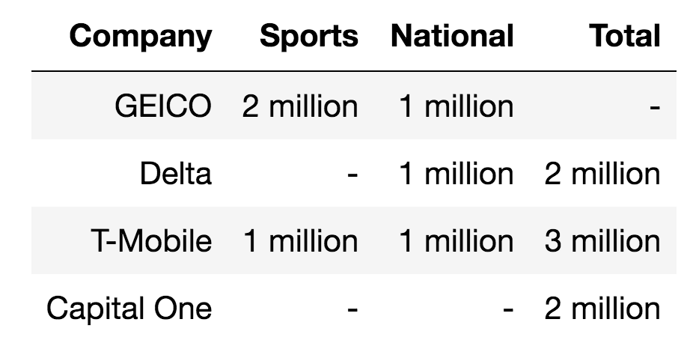
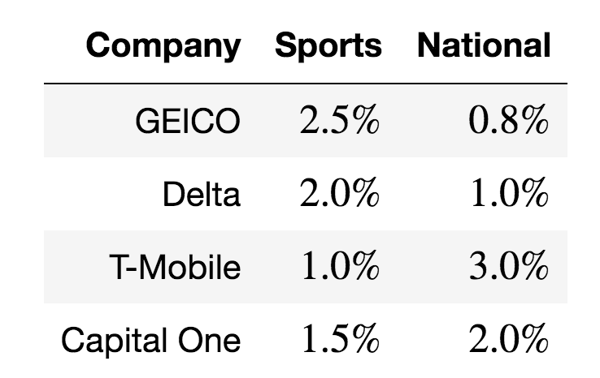
What is the optimal ad placement policy?
Assume that the contract also specifies that The Washington Post receives $2.30 per click-through from each of the four companies. However, not every page view leads to a click. If every 1000 views leads to 5 clicks, the click-through rate is 0.5%. Newspapers use historical data and tracking technologies to determine click-through rates. Assume that the relevant click-through rates are given in the Table 2 below.

Slide 36
Modeling
What are the decisions?
What is the objective function?
What are the constraints?

Slide 37
Mathematical Formulations

Slide 38
Modeling Language

Slide 39
Solution

Slide 40
Take Aways
Modeling + Coding = True Happiness
The trick is not the coding, but the modeling
Duality and Shadow price
Linear programming is a powerful tool

Slide 41
Business Trivia
Why do firms advertise?

